Slide 1


Slide 2
Quote of Wisdom
With faith, discipline and selfless devotion to duty, there is nothing worthwhile that you cannot achieve.
– Quaid-e-Azam Mohammad Ali Jinnah (1876-1948, founder of the Islamic Republic of Pakistan)

Slide 3

IDEOLOGY & CONSTITUTION OF PAKISTAN

Slide 4

Agenda for Today
Political and constitutional developments in Sub-continent (1919 to 1930)

Slide 5

Developments: 1919-1930
Montagu-Chelmsford Constitutional Reforms (1919)
Delhi Muslim Proposals (1927)
Simon Commission (1927)
-- continued

Slide 6
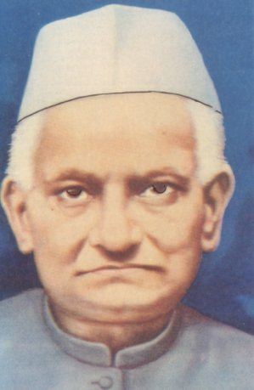
Nehru Report (1928)
Amid opposition to Simon Commission by Congress and Muslim League (and differences between Muslims, Hindus), a Moti Lal Nehru-headed committee was given the task of preparing a 'draft constitution'; committee's work, called Nehru Report, gave its proposals in Aug
Nehru Report exposed, widened Hindu-Muslim rift; Muslims' basic rights were disregarded in the report proposals
--continued

Slide 7
Nehru Report (1928)
Proposals: Govt system with majority to be made sovereign; Separate Muslim electorates to be eliminated; Muslims' demand of 56% seats (Punjab), 55% seats (Bengal), 1/3 representation at centre declined; Hindi should be made official language
A Muslim League committee presented its suggestions for making adjustments in the Nehru Report; the Hindu majority rejected the proposals at the Lucknow All Parties Conference
Quaid-e-Azam at the All Parties Conference was furious over this development

Slide 8
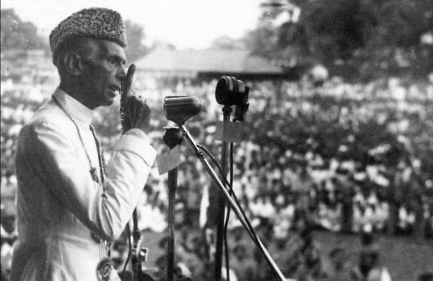
Quaid’s Fourteen Points (1929)
In March 1929, Quaid-e-Azam, responding to the injustice done to Muslims' cause in Nehru Report, presented his Fourteen Points at League's session in Delhi
Points: 1. Muslim representation in centre (1/3) and provinces; 2. Any territorial redistribution not to affect areas of Muslim majority; 3. Religious freedom to all communities
--continued

Slide 9

Quaid-e-Azam’s Fourteen Points
4. Protection of Muslim culture, religion, language, personal laws in the constitution; 5. 1/3 (min) Muslim ministers in provincial, central cabinets; 6 Due share for Muslims in all services, local bodies

Slide 10
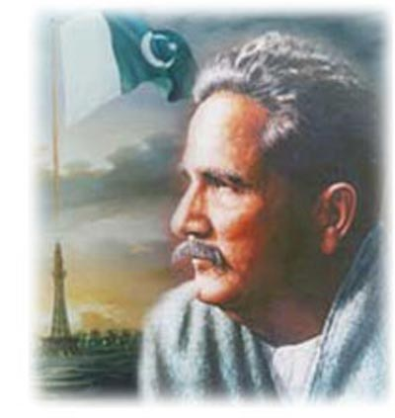
Allama Iqbal's Concept of Separate Homeland
Allama Iqbal holds a highly significant position as one of the most respected Muslim thinkers in history; a poet with a clear vision, Iqbal revived Muslims with his inspirational ideas, poetry; ('Poet of the East')
In 1930 at the Muslim League's annual session in Allahabad, Iqbal for the first time initiated the idea of a separate homeland for the Muslims
--continued

Slide 11
Iqbal’s Allahabad Address
Iqbal in his address said:
“I would like to see the Punjab, NWFP (now called 'Khyber Pakhtunkhwa), Sindh and Balochistan amalgamated into a single state. Self-government within the British Empire or without the Empire, the formation of a consolidated North-West Indian Muslim state appears to me the final destiny of the Muslims, at least of Northwest India.”
Iqbal in this address carried the idea of the Two-Nation Theory to its logical conclusion

Slide 12

Two-Nation Theory: Pakistan's Ideology
Ideology is the very base for the formation of a society
Ideology: A set of beliefs, values, norms, symbols, goals and practices incorporated into generalised conceptualisations about a good society
These conceptualisations cover prominent social, economic and political relationships

Slide 13
Two-Nation Theory
Ideology of Pakistan is established upon the ideals of Islam, i.e. Pakistan is an Islamic state drawing its inspiration and guidance from the Holy Quran, traditions of the Holy Prophet (SAW)
Philosophy of Pakistan Movement indicates Sub-continent Muslims' love for Islam; 'Islamic Millat' was the basic concept behind Pakistan Movement
Pakistan's ideology prompts its citizens to rise above ethnic, territorial and linguistic differences
--continued

